Slide 1
State Management

Slide 2
Motivation
JavaScript single-page applications have become increasingly complicated, our code must manage more state than ever before.
If a model can update another model, then a view can update a model, which updates another model, and this, in turn, might cause another view to update.
At some point, you no longer understand what happens in your app as you have lost control over the when, why, and how of its state.

Slide 3
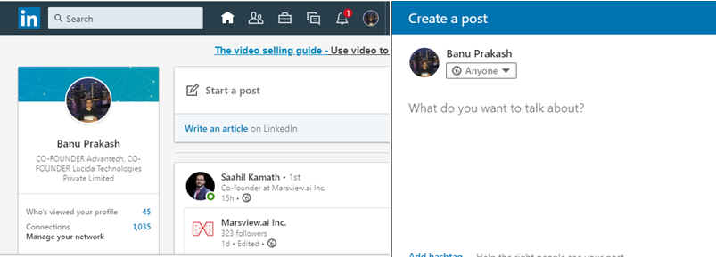
Passing Data Multiple Levels is a Pain
Top-level container has some data, and a child 4+ levels down needs that data. Here’s an example from Linkedin, with all the avatars highlighted:
User Data

Slide 4
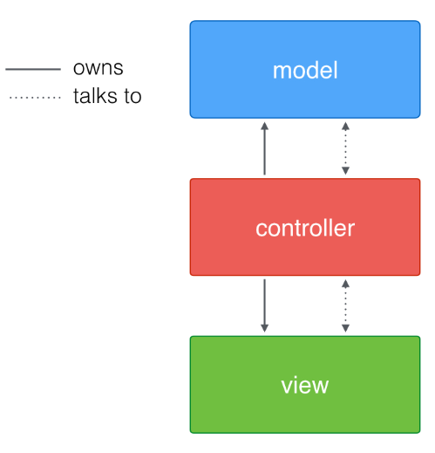
The MVC pattern
In general most MVC patterns considers three roles:
Model: manages the behavior and data of the application domain
View: represents the display of the model in the UI
Controller: takes user input, manipulates the model and causes the view to update
The core ideas of MVC can be formulated as following:
Separating the presentation from the model:
Enables implementation of different UIs and better testability
MVC is a legendary pattern that has been used for various projects since 1976 (it was introduced in Smalltalk-76).

Slide 5
Flux pattern
Flux is a pattern for handling data in your application.
Flux and React grew up together at Facebook.
Many people use them together, though you can use them independently.
They were developed to address a particular set of problems that Facebook was seeing.

Slide 6

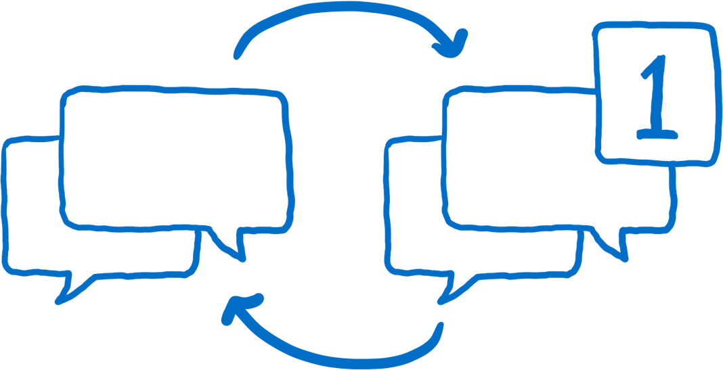
Flux pattern
In Facebook one of the problems was the notification bug.
When you logged in to Facebook, you would see a notification over the messages icon.
When you clicked on the messages icon, though, there would be no new message. The notification would go away.
Then, a few minutes later after a few interactions with the site, the notification would come back.
You'd click on the messages icon again… still no new messages. It would just keep going back-and-forth in this cycle.

Slide 7
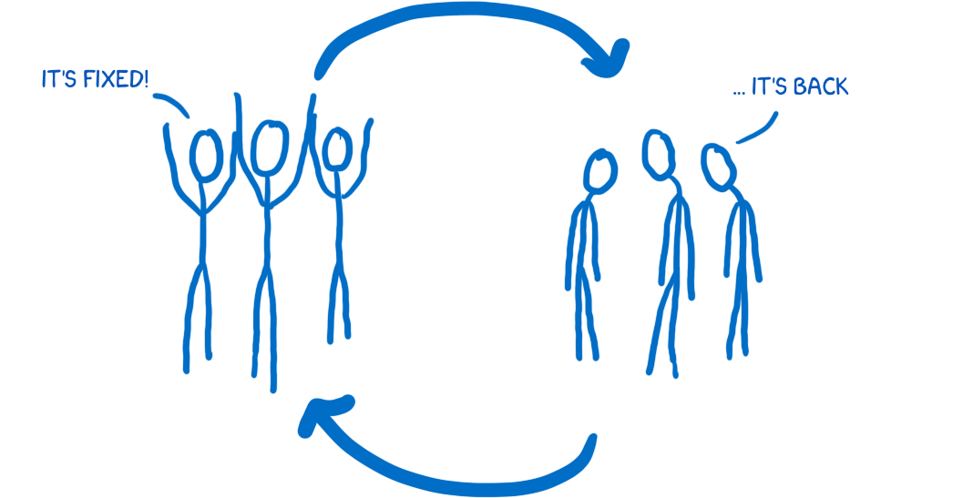
Flux pattern
There was also a cycle going on for the team at Facebook.
They would fix this bug and everything would be fine for a while and then the bug would be back.
It would go back-and-forth between being resolved and being an issue again.
So Facebook wanted to make the system predictable so they could ensure that this problem wouldn’t keep resurfacing.

Slide 8
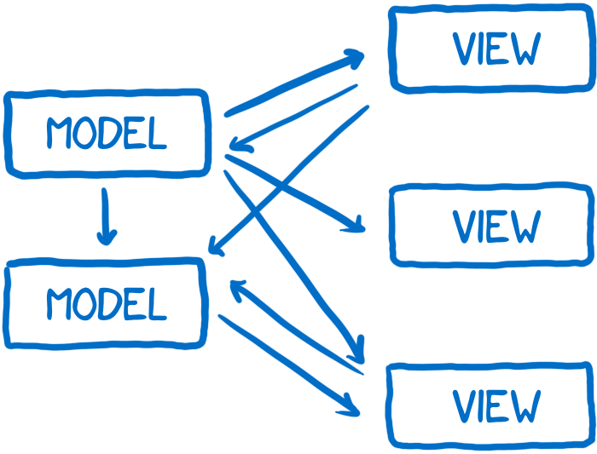
The underlying problem
The underlying problem that they identified was the way that the data flowed through the application.
They had models which held the data and would pass data to the view layer to render the data.
Because user interaction happened through the views, the views sometimes needed to update models based on user input. And sometimes models needed to update other models.
On top of that, sometimes these actions would trigger a cascade of other changes and these changes could be happening asynchronously.

Slide 9
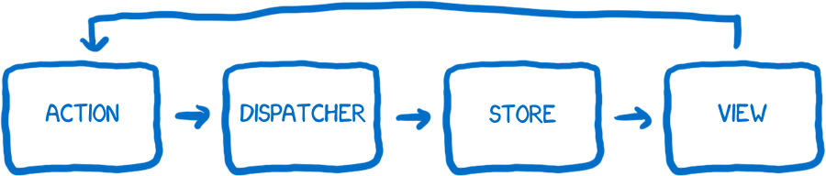
Flux => The solution: unidirectional data flow
Facebook decided to try a different kind of architecture, where the data flows in only one direction, and when you need to insert new data, the flow starts all over again at the beginning.
They called their architecture Flux.

Slide 10

Flux characters
The action creator
Whenever you want to change the state of the app or have the view render differently, you shoot off an action.
You go to the action creator knowing basically what message you want to send, and then the action creator formats that in a way that the rest of the system can understand.
The action creator creates an action with a type and a payload.
The type will be one of the types that you have defined as actions in your system (usually a list of constants).
An example of an action would be something like MESSAGE_CREATE or MESSAGE_READ
Think of the action creator as a telegraph operator.

Slide 11
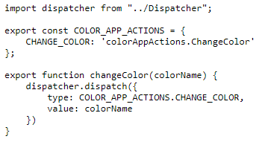
Flux characters: The action creator example

Slide 12
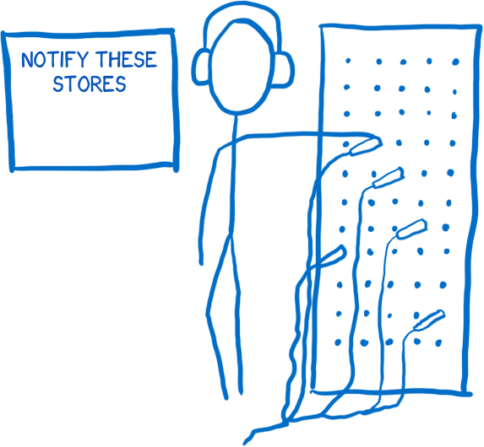
Flux characters
The dispatcher
The dispatcher is basically a big registry of callbacks.
It keeps a list of all of the stores that it needs to send actions to. When an action comes in from the action creator, it will pass the action around to different stores.
The action is sent to all of the registered stores regardless of what the action type is. This means the store doesn’t just subscribe to some actions. It hears about all actions and filters out what it cares about and doesn’t.
Dispatcher is like a telephone operator at a phone switchboard

Slide 13
Flux characters: The dispatcher
import {Dispatcher} from "flux";
export default new Dispatcher();
This is the dispatcher for our app which will dispatch actions invoked in components to the registered stores.

Slide 14

Flux characters
The store
The store holds on to all state in the application, and all of the state changing logic lives inside of the stores.
All state changes must be made by it personally. And you can’t directly request that it change the state.
To request a state change, you must follow proper procedure.
You must submit an action via the action creator/dispatcher pipeline
Think of the store as an over-controlling bureaucrat

Slide 15
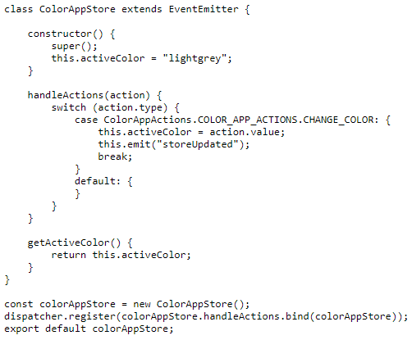
Flux characters: The store

Slide 16

Flux characters
The controller view and the view
The view is a presenter. It isn’t aware of anything in the application, it just knows the data that’s handed to it and how to format the data into output that people understand.
The controller view is like a middle manager between the store and the view. The store tells it when the state has changed. It collects the new state and then passes the updated state along to all of the views under it.

Slide 17
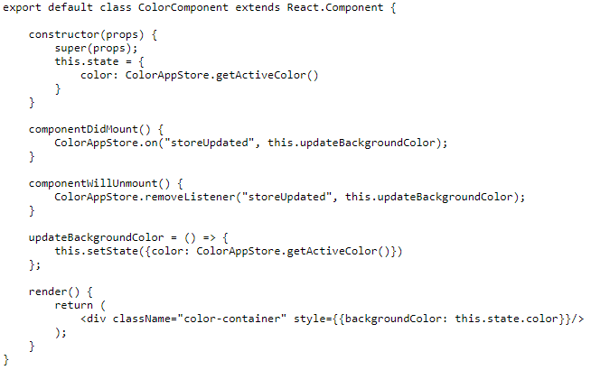
Flux characters: View

Slide 18
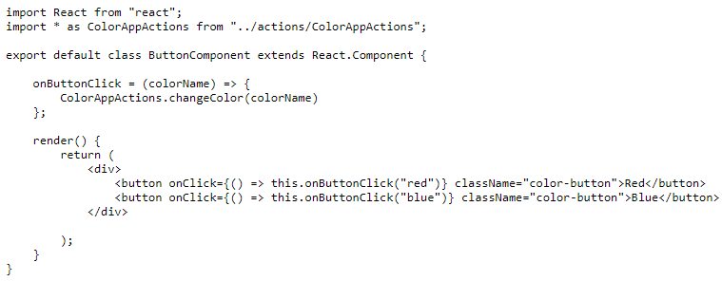
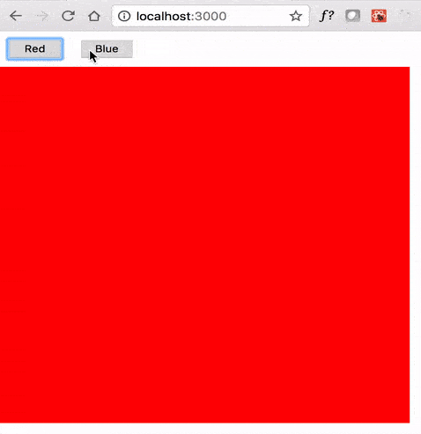
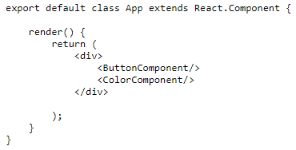
Flux characters: View

Slide 19
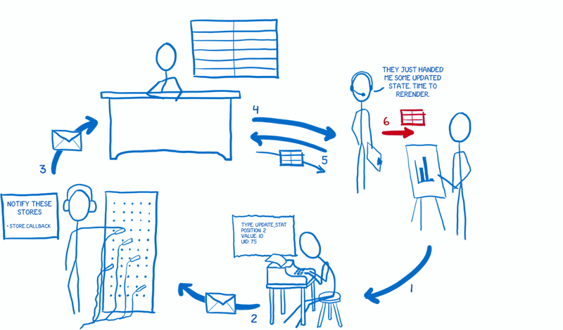
Flux characters
The data flow
The view tells the action creator to prepare an action
The action creator formats the action and sends it off to the dispatcher
The dispatcher sends the action off to the stores in sequence. Each store gets notified of all actions. Then the store decides whether it cares about this one or not, and changes the state accordingly.
Once it’s done changing state, the store lets its subscribed view controllers know.
Those view controllers will then ask the store to give them the updated state.
After the store gives it the state, the view controller will tell its child views to re-render based on the new state.

Slide 20
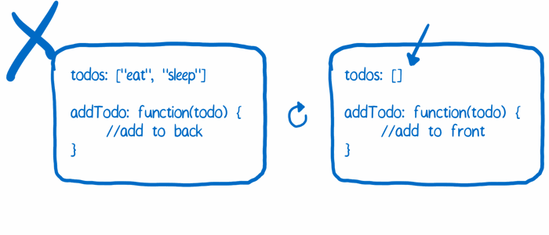
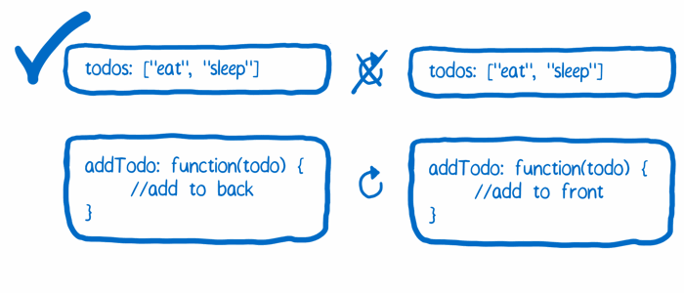
Why change Flux? Problem 1
In Flux, the store contains two things:
The state change logic
The current state itself
Having these two on the same object is a problem for hot reloading. When you reload the store object to see the effect that the new state change logic has, you lose the state that the store is holding on to.
Solution Separate these two functions. Have one object that holds on to the state. This object doesn’t get reloaded. Have another object that contains all of the state change logic. This object can be reloaded because it doesn’t have to worry about holding on to any state.

Slide 21
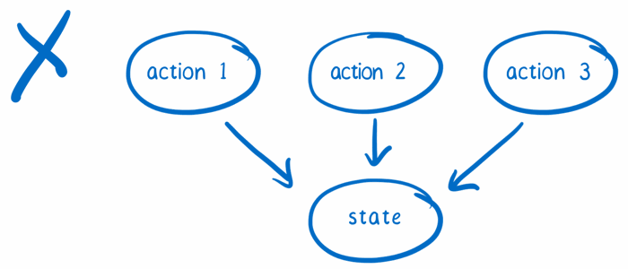
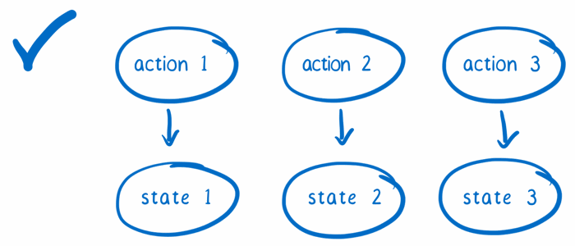
Why change Flux? Problem 2
The state is being rewritten with every action
In time travel debugging, you keep track of each version of a state object. That way, you can go back to an earlier state.
Solution When an action comes in to the store, don’t handle it by changing the state. Instead, copy the state and make changes to the copy.

Slide 22

Redux
The new cast of characters
Action creators
Redux keeps the action creator from Flux. Whenever you want to change the state of the application, you shoot off an action. That’s the only way that the state should be changed.
Unlike Flux, action creators in Redux do not send the action to the dispatcher. Instead, they just return a formatted action object.
Flux | Redux
function addTodo(text) { const action = { type: ADD_TODO, payload: text } Dispatcher.dispatch(action) } | function addTodo(text) { return { type: ADD_TODO, payload: text } }

Slide 23

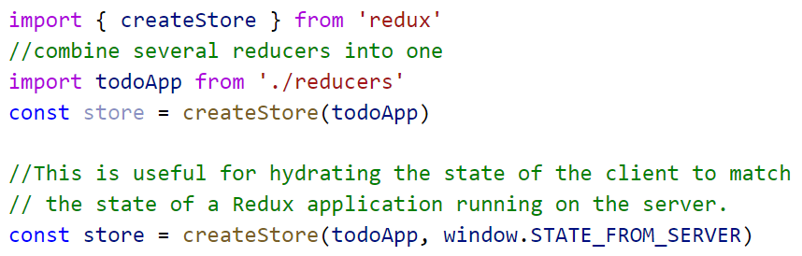
Redux
The store
In Redux, there is only one store…
there’s no dispatcher, the store has also taken over dispatching.

Slide 24
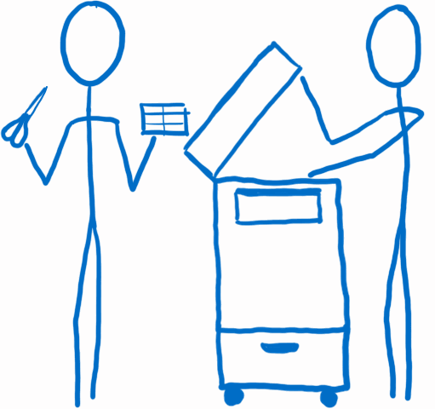
Redux
The reducers
Reducers specify how the application's state changes in response to actions sent to the store.
The root reducer takes charge and slices the state up based on the state object’s keys. It passes each slice of state to the reducer that knows how to handle it.
They don’t change the state that has been passed in to them. Instead, they make a copy and make all their changes on the copy.
The reducers pass their copies back to the root reducer, which pastes the copies together to form the updated state object. Then the root reducer sends the new state object back to the store, and the store makes it the new official state.

Slide 25
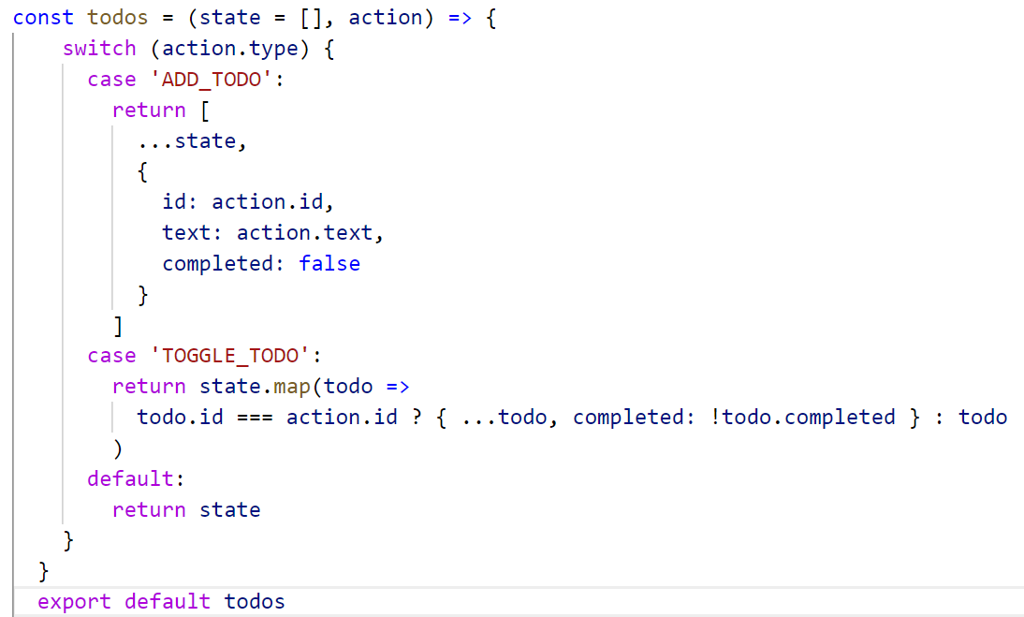
Redux: The reducers
todos.js

Slide 26
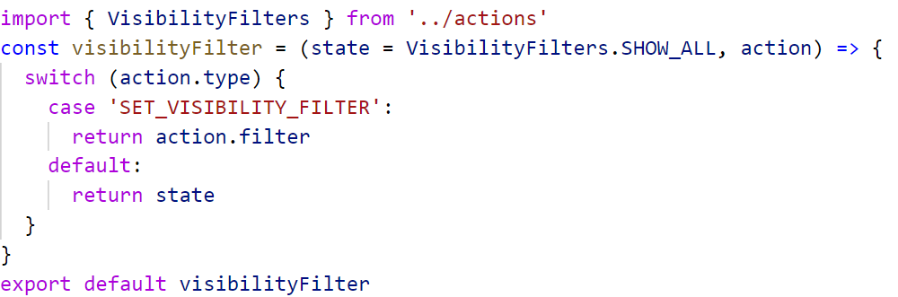
Redux: The reducers
visibilityFilter.js

Slide 27
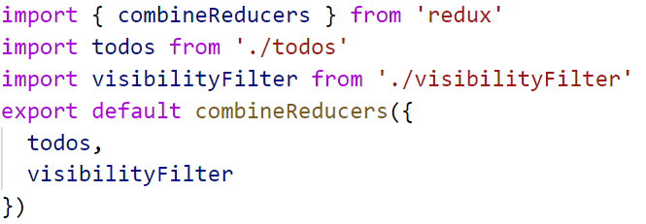
Redux: Combine reducers
index.js

Slide 28

Redux
The views: smart and dumb components
The smart components are the managers.
Smart components are in charge of the actions. If a dumb component underneath them needs to trigger an action, the smart component passes a function in via the props. The dumb component can then just treat that as a callback.
Smart components rarely emit DOM of their own. Instead, they arrange dumb components, which handle laying out DOM elements.

Slide 29

Redux
The view layer binding
To connect the store to the views, it needs something to bind the two together
If you’re using React, this is react-redux.
The view layer binding introduces:
The Provider component: This is wrapped around the component tree. It makes it easy for the root component’s children to hook up to the store using connect().
connect(): If a component wants to get state updates, it wraps itself using connect(). Then the connect function will set up all the wiring for it
The view layer binding is kind of like the IT department for the view tree. It makes sure that all of the components can connect to the store.

Slide 30
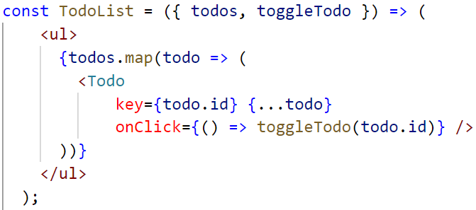
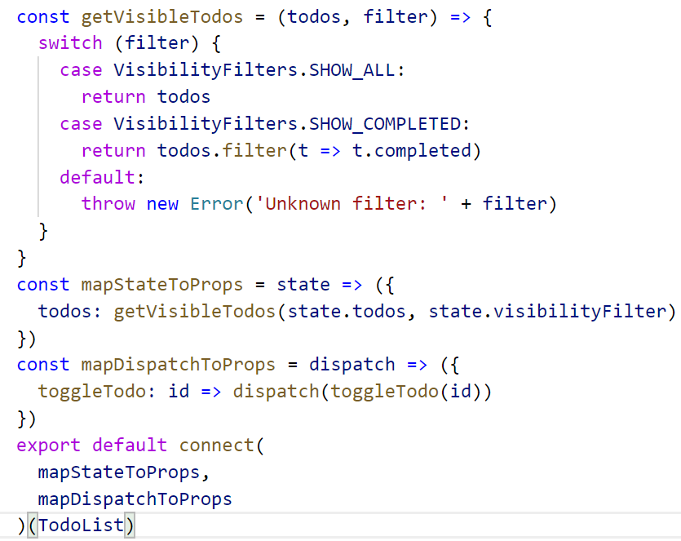
Redux: Dumb & Smart components

Slide 31

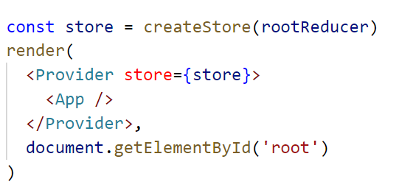
Redux
The root component
It creates the store, telling it what reducer to use, and brings together the view layer binding and the views.
The root component is pretty hands-off after it initializes the app, though.

Slide 32
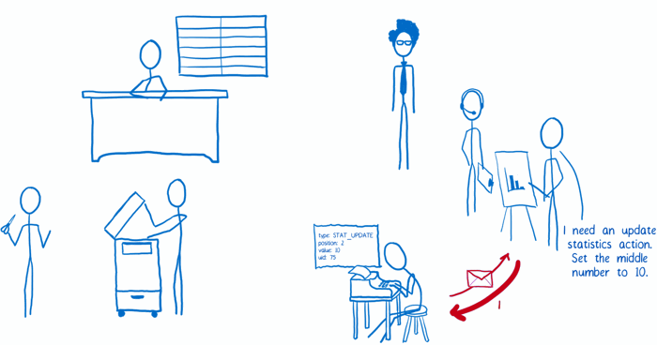
Redux: The data flow
The view requests an action. The action creator formats it and returns it.

Slide 33
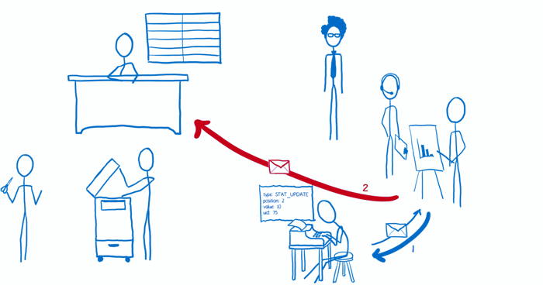
Redux: The data flow
2. View dispatches the action.

Slide 34
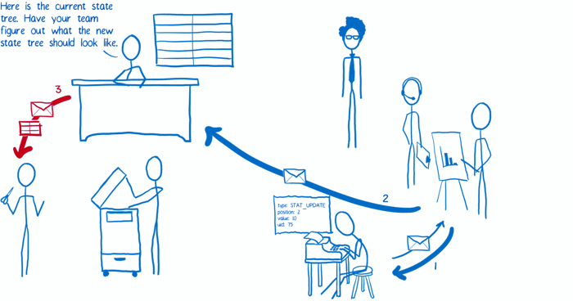
Redux: The data flow
3. The store receives the action. It sends the current state tree and the action to the root reducer.

Slide 35
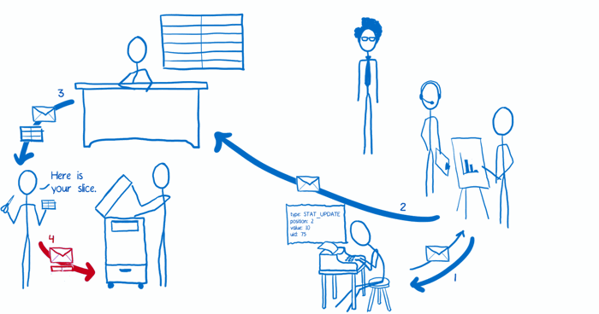
Redux: The data flow
4. The root reducer cuts apart the state tree into slices. Then it passes each slice to the sub-reducer that knows how to deal with it.

Slide 36
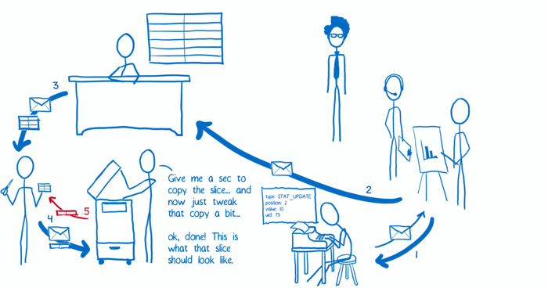
Redux: The data flow
5. The sub-reducer copies the slice and makes changes to the copy. It returns the copy of the slice to the root reducer.

Slide 37
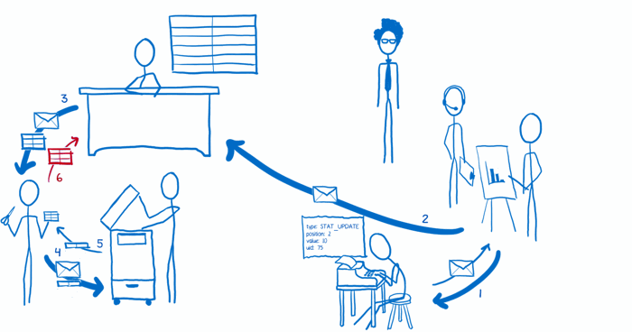
Redux: The data flow
6. Once all of the sub-reducers have returned their slice copies, the root reducer pastes all of them together to form the whole updated state tree, which it returns to the store. The store replaces the old state tree with the new one.

Slide 38
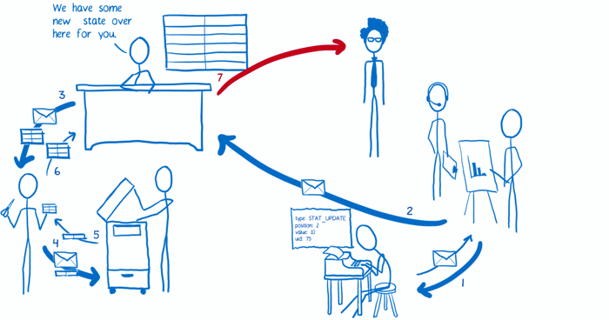
Redux: The data flow
7. The store tells the view layer binding that there’s new state.

Slide 39
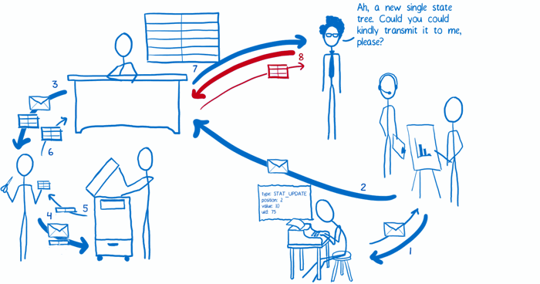
Redux: The data flow
8. The view layer binding asks the store to send over the new state.

Slide 40
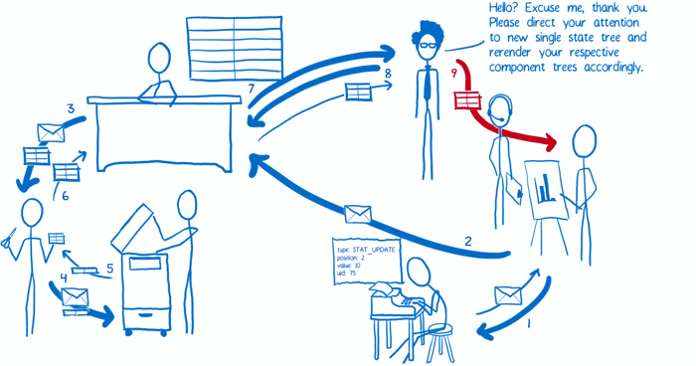
Redux: The data flow
9. The view layer binding triggers a re-render.

Slide 41
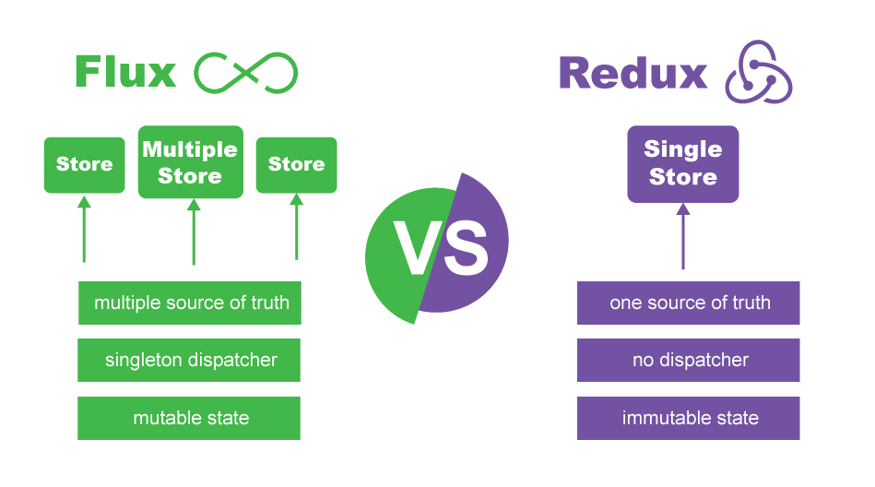

Slide 42
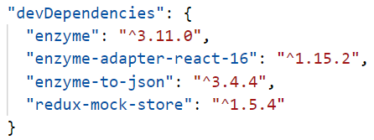
Testing React / Redux Apps with Jest & Enzyme
Dev-Dependencies package.json file:
Enzyme is a JavaScript Testing utility for React that makes it easier to test your React Components' output.

Slide 43
Enzyme
Mount, Shallow, Render
import { mount, shallow, render } from ‘enzyme’;
Mounting
Full DOM rendering including child components
Ideal for use cases where you have components that may interact with DOM API, or use React lifecycle methods in order to fully test the component
As it actually mounts the component in the DOM .unmount() should be called after each tests to stop tests affecting each other
Allows access to both props directly passed into the root component (including default props) and props passed into child components

Slide 44
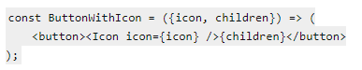
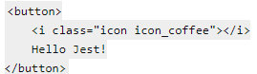
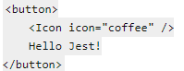
Enzyme
Shallow
Renders only the single component, not including its children. This is useful to isolate the component for pure unit testing.
Render
Renders to static HTML, including children
Does not have access to React lifecycle methods
Less costly than mount but provides less functionality

Slide 45
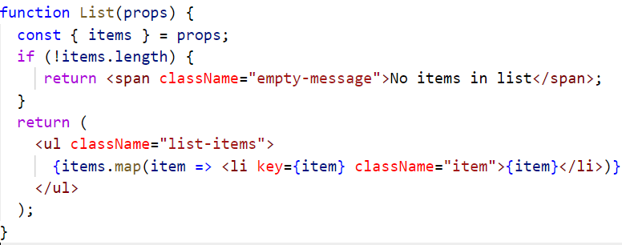
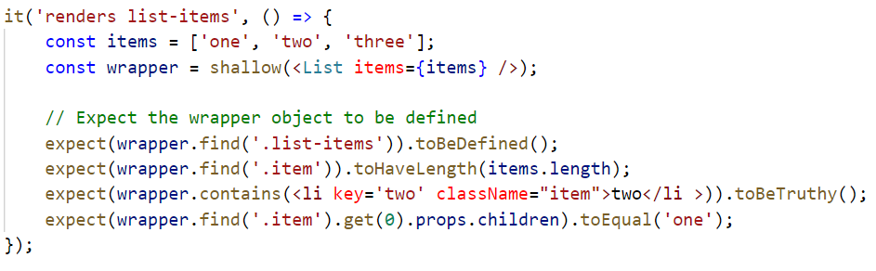
Enzyme Shallow example

Slide 46
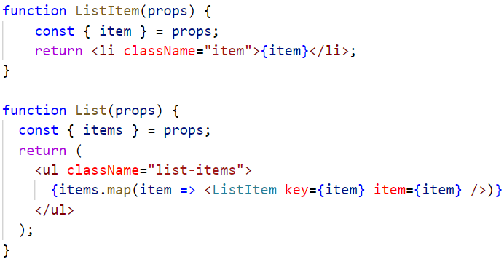
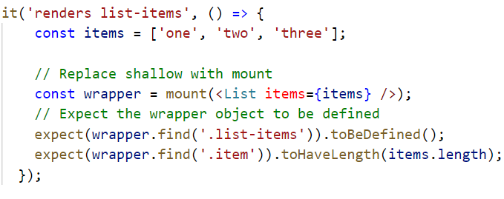
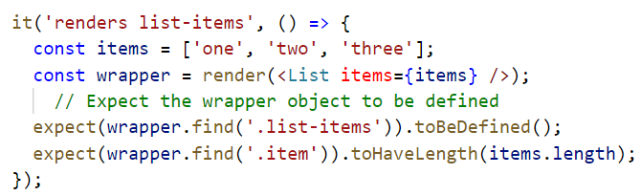
Enzyme mount and render example

Slide 47
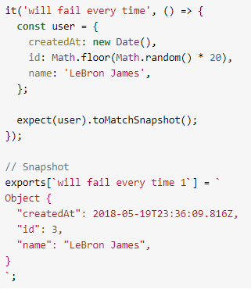
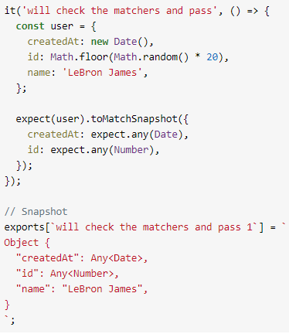
Snapshot testing
Jest snapshots are like those old text UIs with windows and buttons made of text characters: it’s a rendered output of your component stored in a text file.

Slide 48
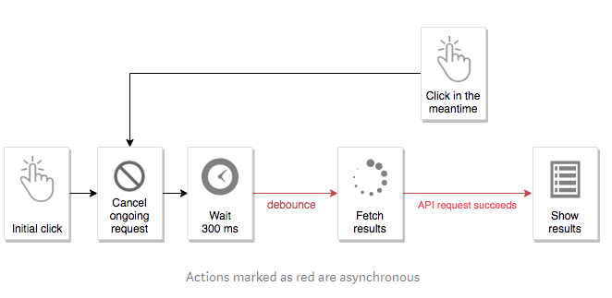
Handling Asynchronous Actions in Redux
Synchronous Redux reducer ends up not being enough, because many effects of UI actions are asynchronous, i.e.:
Actions such as “filtering search results” and “retrieving API response” take time and can’t be dispatched immediately,
Actions such as “cancel the ongoing request” need to rely on other actions (not the reducer’s state).

Slide 49
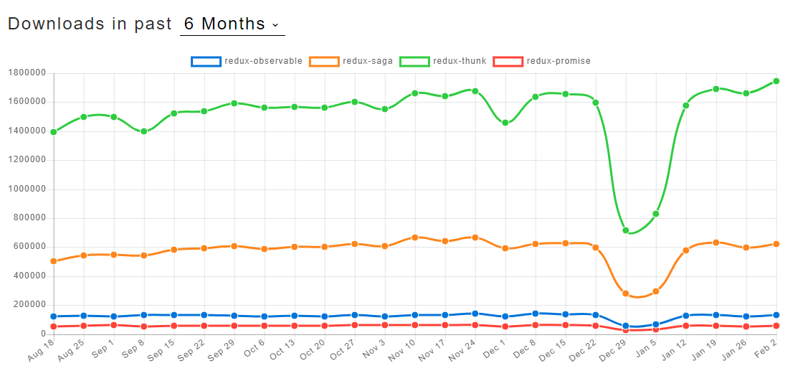
Current approaches to the problem
An action creator that returns a function which will dispatch multiple actions over time
redux-thunk
redux-promise
A “4th” element in the Redux store, that listens to the actions, acts on them, and dispatches another actions in the background as a result
using JS generators syntax and custom APIs
redux-saga
redux-ship
using Observables
redux-effects
redux-cycles

Slide 50
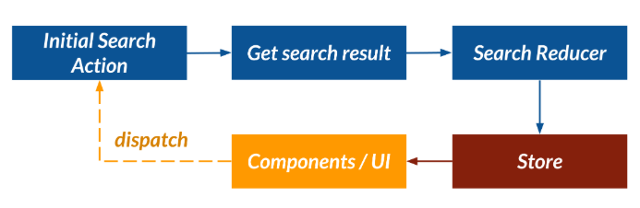
Redux way
When a user performs a search action, we want to update the store with a new search result via searchReducer.
We can then render our components accordingly. The general flow of events looks like this:

Slide 51

Redux Thunk way
Make a remote API call to our backend API server.
When the request receives a successful JSON response, we’ll dispatch the searchSuccess action along with the payload to searchReducer.
The statusReducer is responsible for tracking state changes whenever a user performs an action.
Pending (when a user first initiates the action)
Success (when a request returns a successful response)
Error (when a request returns an error response)

Slide 52


Redux Thunk way: SearchAction

Slide 53


Redux Thunk way: StatusReducer.js

Slide 54

Redux Thunk way: SearchReducer.js

Slide 55

Redux Thunk way: store.js

Slide 56


Redux Thunk way: Container component

Slide 57

Unit Tests for Asynchronous Redux Thunks
Basic asynchronous login thunk example

Slide 58

Unit Tests for Asynchronous Redux Thunks
Mock dependencies
Here we will mock the login API method:

Slide 59

Unit Tests for Asynchronous Redux Thunks
Test One: Dispatching a login request
First we use Jest to create a spy for the dispatch function.
loginThunk('username', 'password') returns the thunk action, which has the signature (dispatch: Dispatch) => Promise<void>. Then the test passes in the dispatch spy and waits for the promise to resolve or reject.
Once the promise has resolved (i.e. once the thunk has completed) the test then validates that the dispatch method received a call with a loginRequest action.

Slide 60

Unit Tests for Asynchronous Redux Thunks
Test Two: When login succeeds

Slide 61

Unit Tests for Asynchronous Redux Thunks
Test three: When login fails

Slide 62

Redux Saga
Redux-Saga is a library that aims to make application side effects (e.g., asynchronous actions such as fetching data) easier to handle and more efficient to execute.
Saga is similar to a separate thread in your application that’s solely responsible for side effects
Unlike Redux-Thunk, which utilizes callback functions, a Redux-Saga thread can be started, paused and cancelled from the main application with normal Redux actions.
Like Redux-Thunk, Redux-Saga has access to the full Redux application state and it can dispatch Redux actions as well.

Slide 63

Redux Saga
Redux-Saga utilizes a new ES6 feature called generators.
Generators are functions which can be exited and later re-entered.
Calling a generator function, marked by the asterisk to the right of the function keyword, will return an iterator.
When the iterator’s next method is invoked, the generator function’s body is executed up until the first yield (e.g., line 2 above).
The iterator’s next method returns an object with a value property containing the yielded value and a done boolean property, which indicates whether the generator has yielded its last value.

Slide 64
Redux Saga
When to use Redux Saga?
In an application using Redux, when you fire an action something changes in the state of the app.
As this happens, you might need to do something that derives from this state change.
For example you might want to:
make a HTTP call to a server
send a WebSocket event
fetch some data from a GraphQL server
save something to the cache or browser local storage
Those are all things that don’t really relate to the app state, or are async, and you need to move them into a place different than your actions or reducers (while you technically could, it’s not a good way to have a clean codebase).

Slide 65
Redux Saga
How it works
A saga is some “story” that reacts to an effect that your code is causing.
Create a middleware with a list of sagas to run, which can be one or more, and we connect this middleware to the Redux store.
The first step of saga functioning begins with the operation and execution of a promise.
After this cycle, the middleware suspends the saga until the time a promise is resolved.
After the latter step, the middleware restores the saga until the determination of the yield statement.
Thereafter, the saga is suspended again until the resolution of the promise. This circle continues.

Slide 66

Redux Saga helper functions
take
Use this when: You want to watch for a particular redux action to be dispatched, but you don't want to listen for that same dispatched action again until the currently running saga for that action has complete.
You're "blocking" the ability to watch for when that particular redux action is dispatched until the currently running saga for that redux action has complete.
Use case: Deleting a user, or accepting a payment.

Slide 67

Redux Saga helper functions
takeEvery
Use this when: You want to watch for EVERY time a specific redux action was dispatched.
Use case: Getting / fetching a list of data from an API.

Slide 68
Redux Saga helper functions
takeLatest
Use this when:
to ONLY take the latest currently running saga for the associated dispatched redux action.
call
Use this when:
You want to call a function or a promise but want to wait for that function or promise to finish running before executing the next line of code.

Slide 69
Redux Saga helper functions
put
Use this when: You want to dispatch a redux action from within a redux saga.
put({ type: 'PRODUCTS_RECEIVED', products })

Slide 70

Redux Saga helper functions
Running effects in parallel
all()
all() won’t be resolved until both call() return

Slide 71

Redux Saga helper functions
Running effects in parallel
race( )
It’s a race to see which one finishes first, and then we forget about the other participants.
It’s typically used to cancel a background task that runs forever until something occurs:

Slide 72


Redux-Thunk Vs Redux-Saga

Slide 73
Higher-Order Component
Higher-order component is a function that takes (wraps) a component and returns a new component
They are a pattern that stems from React’s nature that privileges composition over inheritance
Types of Higher-Order Components
Props Proxy (ppHOC)
Inheritance Inversion (iiHOC)

Slide 74

HOC: Props Proxy (ppHOC)
Props Poxy takes a Component as an argument and returns a new component.
Props Proxy HOCs are useful to the following situations:
Manipulating props
Abstracting State
Wrapping/Composing the WrappedComponent with other elements

Slide 75

HOC: Inheritance Inversion (iiHOC)
Inheritance Inversion gives the HOC access to the WrappedComponent instance, which means you can use the state, props, component lifecycle and even the render method.
Inversion Inheritance HOCs are useful for the following situations:
Render High-jacking
Manipulating state

Slide 76


HOC example

Slide 77
HOC: use case
You may have a good use-case for HOCs if:
For cross-cutting concerns
The behavior is not specific to any single component, but rather applies to many or all components in the app
Components can be used stand-alone without the behavior from the HOC.
No custom logic needs to be added to a component being wrapped by the HOC.

Slide 78

Props
In React the primary mechanism for communication between your components is through properties, or props, for short

Slide 79

Context
Context is designed to share data that can be considered “global” for a tree of React components, such as the current authenticated user, theme, or preferred language
Context acts like a portal in your application in which components can make data available to other components further down the tree without being passed through explicitly as props

Slide 80


Context: Create provider and consumer components

Slide 81

Context: using the Provider
The <UserProvider> component needs to wrap around all components that share state.

Slide 82

Context: Using the consumer to read state

Slide 83

Context: Using the consumer to update the state

Slide 84


React Hooks
Hooks are a new addition in React 16.8. They let you use state and other React features without writing a class.
React’s State Hook
Here, useState is a Hook. We call it inside a function component to add some local state to it. React will preserve this state between re-renders. useState returns a pair: the current state value and a function that lets you update it.

Slide 85

React Hooks
Using Multiple State Hooks
We can even use useState() multiple times in the same function.

Slide 86
React’s Effect Hook
Effects are similar to componentDidMount, componentDidUpdate, and componentWillUnmount.
This is what the Effect Hook is for. Side-effects are things you want your application to make like:
Fetching data
Manually changing the DOM (document title)
Setting up a subscription
Effects will run after every render, including the first render.

Slide 87


React’s Effect Hook
useEffect similar to componentDidMount and componentDidUpdate.

Slide 88

React’s Effect Hook

Slide 89

React Performance

Slide 90

React Performance
shouldComponentUpdate
The shouldComponentUpdate method is called every time a component receives new props or changes its state and is one of the primary ways to optimize your React app’s performance.
shouldComponentUpdate receives the next state and props of the Component, which we can use to compare to the current state of the Component and then return a boolean whether we want to re-render or not.

Slide 91

React Performance
PureComponent
The React team determined that in most cases people just simply compared if the props or state have changed in order to trigger the re-render.
This is why they created React’s PureComponent.

Slide 92

React Performance
React memo
React team released React.memo, which means that you no longer need to refactor your functional Component to a class Component in order to take advantage of this functionality

Slide 93


React Performance
Binding in Constructor vs Arrow Functions
Regular functions are added to the Component’s prototype while Arrow functions become an instance property.

Slide 94


React Performance
Avoid binding/inlining when rendering
if you perform some kind of inlining or binding in render you are always triggering a re-render.

Slide 95


React Performance
Not using (proper) keys
React needs a key prop when rendering lists so that it knows which elements have been added, removed or changed.
This improves the rendering performance of the list because if something changes in the absence of keys React will re-render the entire list and you can imagine the cost it bears when rendering a big list.
Using indexes as keys is also a bad practice because then your list becomes dependent on the order of the elements, which leads to bugs if you attempt to sort the list or add new elements to it.

Slide 96


React Performance
Use React.Fragments to Avoid Additional HTML Element Wrappers
OR

Slide 97

React Performance
Debouncing Event Action in JavaScript
debouncing is a technique to prevent the event trigger from being fired too often.

Slide 98
React Performance
Avoid Async Initialization in componentWillMount()
componentWillMount() is only called once and before the initial render.
Since this method is called before render(), our component will not have access to the refs and DOM element. [ Use componentDidMount instead]
The componentWillMount() is good for handling component configurations and performing synchronous calculation based on props since props and state are defined during this lifecycle method.

Slide 99


React Performance
Using Web Workers for CPU Extensive Tasks
What happens when we have 20,000 posts? It will slow down the rendering since the sort method will run in the same thread.

Slide 100

React Performance using Web Worker

Slide 101


React Performance using Web Worker
Use Web Workers for tasks like image processing, sorting, filtering, and other CPU extensive tasks.

Slide 102


React Performance
Consider Server-side Rendering
Server-side rendering provides performance benefit and consistent SEO performance
React app page source without server-side rendering
The browser will also fetch the app.js bundle, which contains the application code and render the full page after a second or two.

Slide 103

React Performance
Consider Server-side Rendering
The same app with server-side rendering enabled:
We see that only one trip to the server happens before the users get their content.
When the browser requests a page, the server loads React in the memory and fetches the data required to render the app.
After that, the server sends generated HTML to the browser, which is immediately shown to the user. [Time to First Meaningful Paint]
Some popular solutions that provides SSR for React apps:
Next.js
Gatsby

Slide 104



React Performance
Using next.js [ npm i --save next ]

